Slide 1
Android Network Operations

Slide 2
Android Network
A device can have various types of network connections.
Android lets your application connect to the internet or any other local network and allows you to perform network operations.
Notes:
There are different libraries available to perform network call in android, eg. Retrofit, Volley, OKHTTP (HTTP + HTTP /2) etc, however what, if you want to do a raw implementation without any library, then you have the option HttpUrlConnection.

Slide 3
ConnectivityManager
Before you perform any network operations, you must first check that are you connected to that network or internet e.t.c.
For this android provides ConnectivityManager class. You need to instantiate an object of this class by calling getSystemService() method.

Slide 4
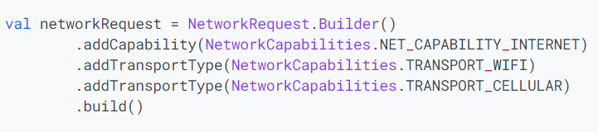
ConnectivityManager (Cont…)

Slide 5
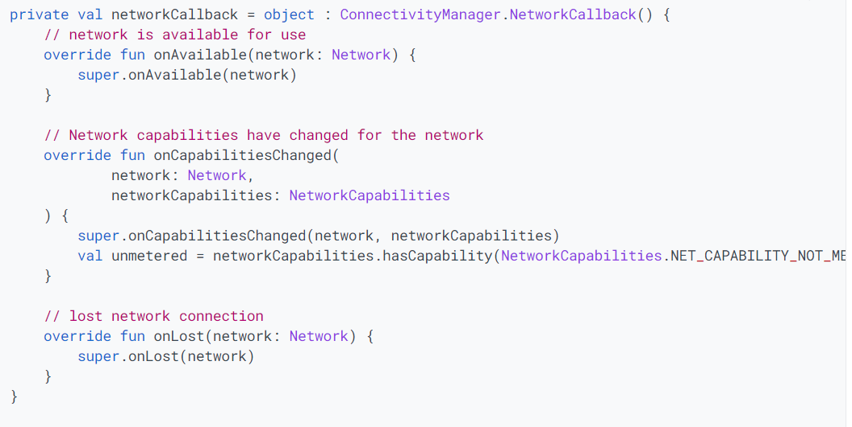
Network Callbacks

Slide 6
Connecting to the Network
After checking that you are connected to the internet, you can perform any network operation. Here we are fetching the html of a website from a url.
Android provides HttpURLConnection and URL class to handle these operations. You need to instantiate an object of URL class by providing the link of website

Slide 7
Connecting to the Network (Cont…)
After that you need to call openConnection method of url class and receive it in a HttpURLConnection object

Slide 8
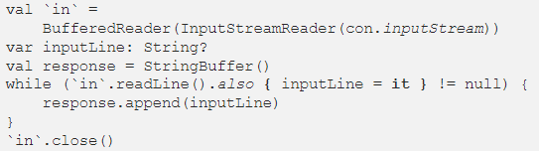
Reading Data from URL
And the last thing you need to do is to fetch the HTML from the website. For this you will use InputStream and BufferedReader class

Slide 9
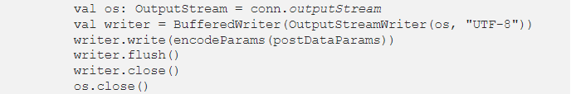
Sending Data to URL
Notes:
https://medium.com/@ajay.dewari/connect-android-app-to-the-network-using-httpurlconnection-79a55c8c624e

Slide 10
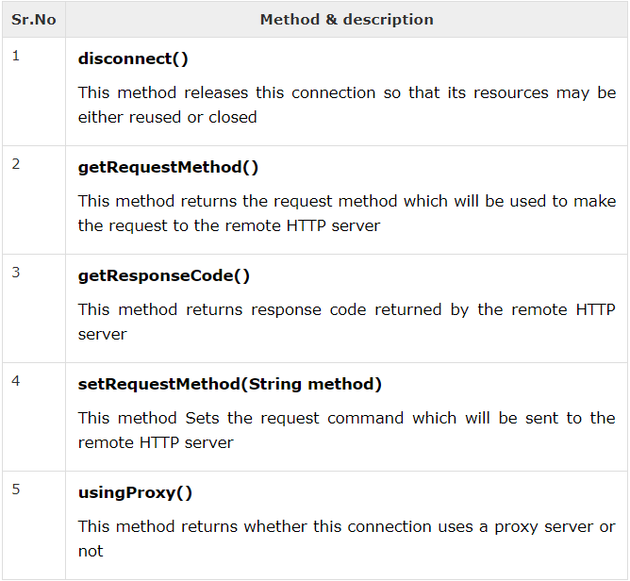
Other HTTPURLConnection Methods

Slide 11
Task .. Download image from given URL
http://www.tutorialspoint.com/green/images/logo.png

Slide 12
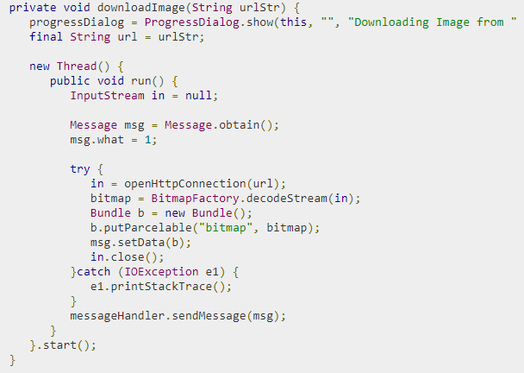
Image Downloading Code

Slide 13
URL url = new URL(“write url here"); HttpURLConnection urlConnection = (HttpURLConnection) url.openConnection(); InputStream in = urlConnection.getInputStream();
Bitmap bmp = BitmapFactory.decodeStream(in);

